Slide 1
Sales and Use Tax Training for Grocers Part 2 Wisconsin Department of Revenue April 2017

Slide 2
Topics of Discussion
Sales of Candy
Sales of Soft Drinks
Sale of Dietary Supplements

Slide 3
Additional Training for Grocers
Part 1 – Resources and Sales by Grocers
Part 3 - Sales of Prepared Foods
Part 4 - Preparing for an Audit

Slide 4
Sales of Candy, Soft Drinks, and Dietary Supplements

Slide 5
Exemption for Food and Food Ingredients
The sales price from the sale of and the storage, use, or other consumption of food and food ingredients, except:
Candy
Soft drinks
Dietary supplements
Prepared food (see Part 3)

Slide 6
Definition of Candy
Preparation of:
Sugar, honey, or other natural or artificial sweeteners
Combined with chocolate, fruit, nuts, or other ingredients or flavorings
In the form of bars, drops, or pieces
Candy does not include a preparation that contains flour or requires refrigeration.

Slide 7
Candy – Examples
 | Candy | Not Candy
Licorice (contains flour) |  | X
Ice cream sandwich (frozen) |  | X
Chocolate chips (sweetened) | X
Chocolate-covered pretzels (contains flour) |  | X
Honey roasted peanuts | X
Marshmallows | X
Snickers Bar | X
Twix Bar (contains flour) |  | X

Slide 8
Definition of Soft Drink
A beverage that contains a natural or artificial sweetener
Does not include:
Alcoholic beverages (0.5% or more alcohol)
Beverage that contains milk or milk products; soy, rice, or similar milk substitutes
Beverage that contains more than 50% vegetable or fruit juice

Slide 9
Soft Drink – Examples
 | Soft Drink | Not Soft Drink
Iced Tea (unsweetened) |  | X
Iced Tea (sweetened) | X
Bottled Water (unsweetened) |  | X
Bottled Water (sweetened) | X
Fruit Drink (more than 50% fruit juice) |  | X
Protein Drink (with milk and sweetener) |  | X
Strawberry Milk |  | X

Slide 10
Definition of Dietary Supplement
A product intended to supplement a person's diet that meets all of the following:
Contains a vitamin, mineral, herb, botanical, amino acid or other dietary substance to supplement the diet,
Is intended for ingestion in tablet, powder, capsule, gel-cap or if not in such forms, not represented as conventional food or intended to be the sole item of a meal or diet, and
Is labeled as a dietary supplement (21 C.F.R 101.36)

Slide 11
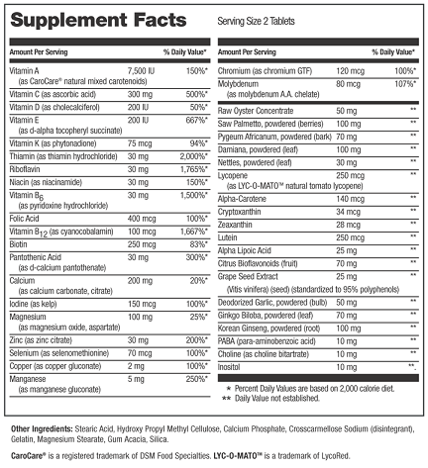
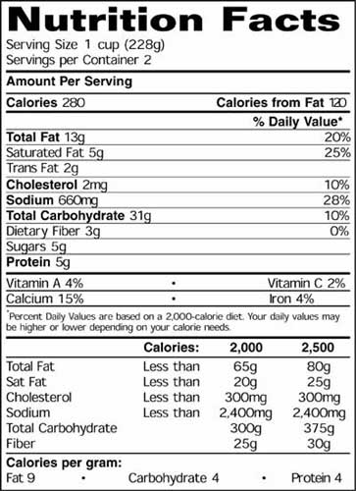
Supplement Facts vs. Nutrition Facts

Slide 12
Additional Training for Grocers
Part 1 – Resources and Sales by Grocers
Part 3 - Sales of Prepared Foods
Part 4 - Preparing for an Audit

Slide 13
Contact DOR if you have questions
WISCONSIN DEPARTMENT OF REVENUE Customer Service Bureau PO Box 8949, MS 5-77 Madison, WI 53708-8949
Phone: (608) 266-2776 Email: DORSalesandUse@wisconsin.gov

